Slide 1
Light Gradient Boosting Machine(Light GBM)

Slide 2
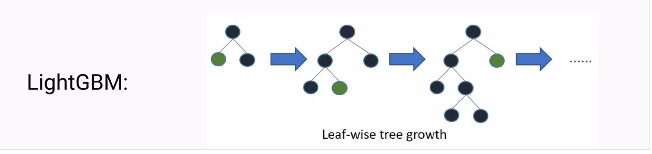
Tree Model

Slide 3
Feature Engineering
Built-in Regularization to prevent overfitting
Supports parallel learning
Supports both regression and classification

Slide 4
Advantage
Faster training speed and higher efficiency
Lower memory usage
Better accuracy than any other boosting algorithm

Slide 5
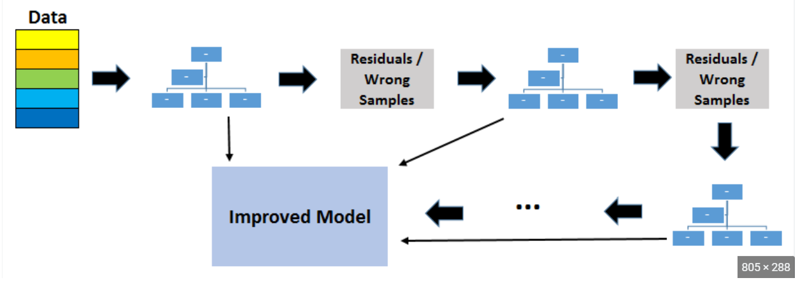
Model Creation

